Slide 1
Deep SLAM
Progress Report
Rui Zhu, You-Yi Jau
2019/03/13

Slide 2
Outlines
Motivation
Proposed method
Implementation
Contributions
References

Slide 3
Motivation
Classic SLAM
Modules are designed heuristically
Submodules are optimized individually
Good keypoints/correspomndences should be pose-aware
Can deep learning help?
Image 1:
I_{t}
Confidence mask
Feature detector/ descriptor
Feature Correspondence
RANSAC
Pose/ Depth
Image 2: I_{t+1}
Confidence mask
Feature detector/ descriptor
Notes:
Optimize the modules based on output error (keypoint reprojection error)
Self-supervised training using estimated pose and depth.
fine-tune to generalize in any scenes
Use temporal information to adapt keypoint selector (attention map)
1 img → 2 img to optimize
-----
Approach
Train dense detecting mask based on the output pose.
Train descriptor based on the dense correspondence image.

Slide 4
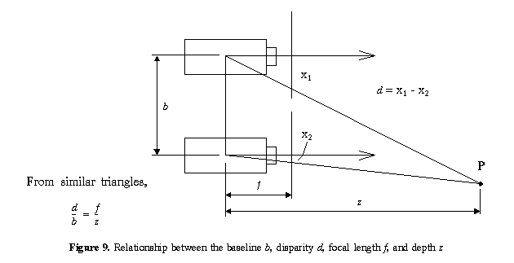
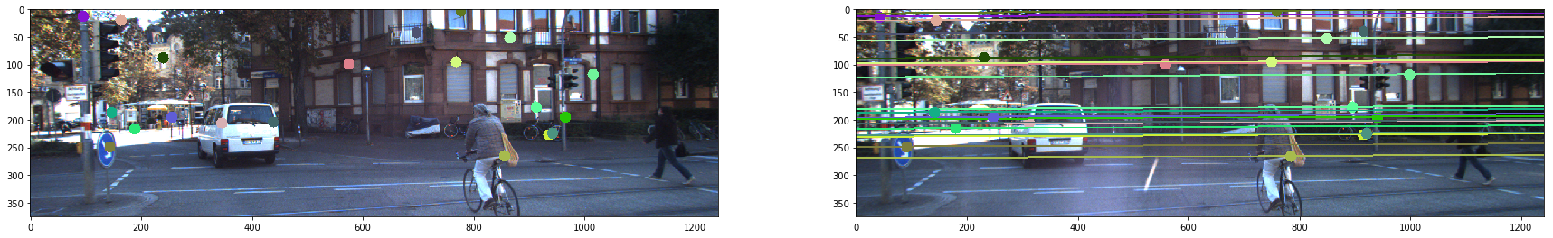
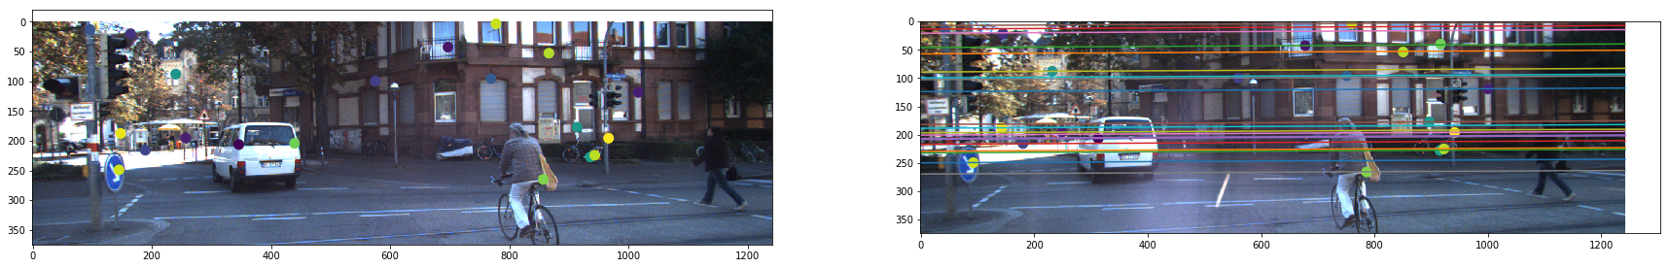
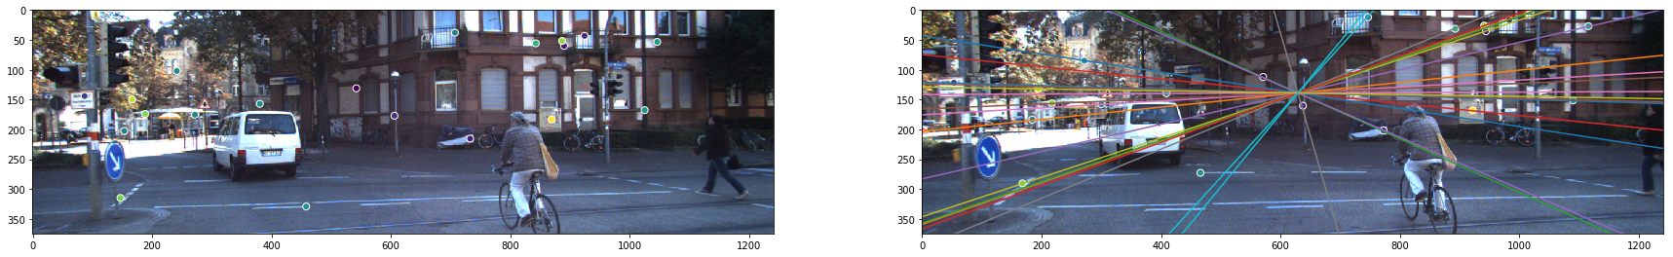
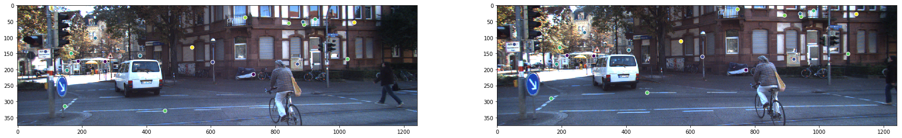
Motivation
I_{t_left}
Horizontal motion; points close-by matter more
I_{t_right}
Forward motion; points far from the vanishing points matter more
Motivation:
Train motion-aware keypoint detector/descriptor, matching, and RANSAC modules
Also for Rotational motion; points close to the vanishing points are really important
I_{t+1_left}
Notes:
Optimize the modules based on output error (keypoint reprojection error)
Self-supervised training using estimated pose and depth.
fine-tune to generalize in any scenes
Use temporal information to adapt keypoint selector (attention map)
1 img → 2 img to optimize
-----
Approach
Train dense detecting mask based on the output pose.
Train descriptor based on the dense correspondence image.

Slide 5
Motivation
Modules are designed heuristically
Submodules are optimized individually
Can deep learning help?
Image 1: Img_1
Depth
Modules
Image 2: Img_2
Camera Pose

Slide 6
Keypoint-based method: Our method
Goal
Self-supervised training on sequences based on estimated pose and depth.
Gradients back-proped to keypoint detector/ descriptor modules
Even further, keypoint selection with confidence/weight mask
Fine-tune
Image 1:
I_{t}
Confidence mask
Keypoint detector/ descriptor
Feature Correspondence
RANSAC
Pose/ Depth
Image 2: I_{t+1}
Confidence mask
Keypoint detector/ descriptor
Notes:
Optimize the modules based on output error (keypoint reprojection error)
Self-supervised training using estimated pose and depth.
fine-tune to generalize in any scenes
Use temporal information to adapt keypoint selector (attention map)
1 img → 2 img to optimize
-----
Approach
Train dense detecting mask based on the output pose.
Train descriptor based on the dense correspondence image.

Slide 7
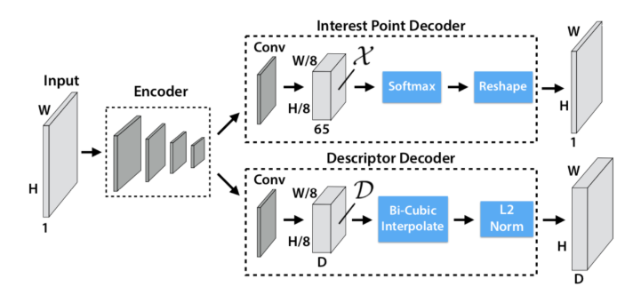
Implementation - first half
More options if you were at Rui’s 3D reading group pre.
Image 1:
I_{t}
Feature detector & descriptor
SuperPoint:
First: reimplement the SuperPoint module: (@Youyi)
Input: Image pair
Output: correspondences
Consisting of keypoint detector, descriptor, and correspondence by nearest neighbor
Dataset: first follow Superpoint on synthetic data for validation, then switch to KITTI with GT from Holography Adaptation or SLAM
Encoder
Det Decoder
Desc Decoder
Feature Correspondence
Nearest Neighbor
Image 2: I_{t+1}
Keypoint selector (attention)
Feature detector/ descriptor

Slide 8
Implementation - second half
First reimplement the DSAC module to pose from correspondences: (@Rui)
Adapt from the PyTorch implementation of DSACLine
First validate on image alignment with homography estimation
Facial landmark dataset
Then move on to camera pose from correspondences
KITTI
Feature Correspondence
RANSAC
Pose/ Depth
Nearest Neighbor
DSAC

Slide 9
Implementation - combine
After pre-training, fine-tune with unsupervised loss, with confidence score from the DSAC module
Either reweight the correspondences with confidence score to fine-tune the detector/descriptor module
Or learn an extra confidence map over the keypoints/correspondences
Image 1:
I_{t}
Feature detector & descriptor
SuperPoint:
Encoder
Det Decoder
Finetune by re-weighting GT
Desc Decoder
Feature Correspondence
RANSAC
Pose/ Depth
Confidence mask
Nearest Neighbor
DSAC
Learn confidence map for scoring
Image 2: I_{t+1}
Keypoint selector (attention)
Feature detector/ descriptor

Slide 10
Progress @Youyi
Re-implementing the SOTA keypoint detector/descriptor on single image

Slide 11
Last time
Train on synthetic/ Homography adaptation

Slide 12

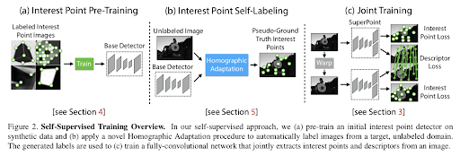
Superpoint pipeline

Slide 13
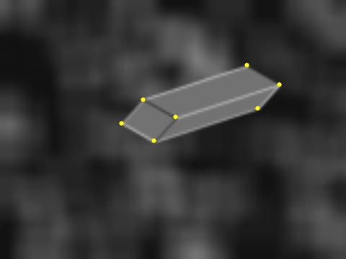
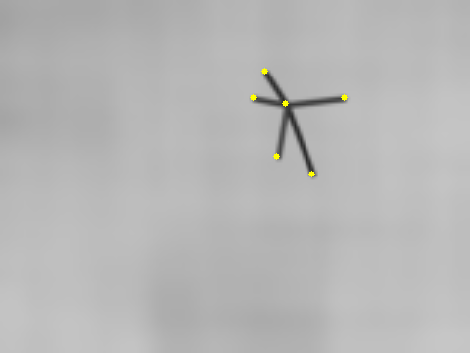

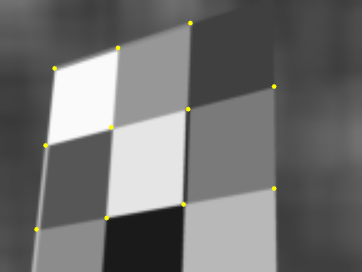
1: Base detector on synthetic data
Good results

Slide 14
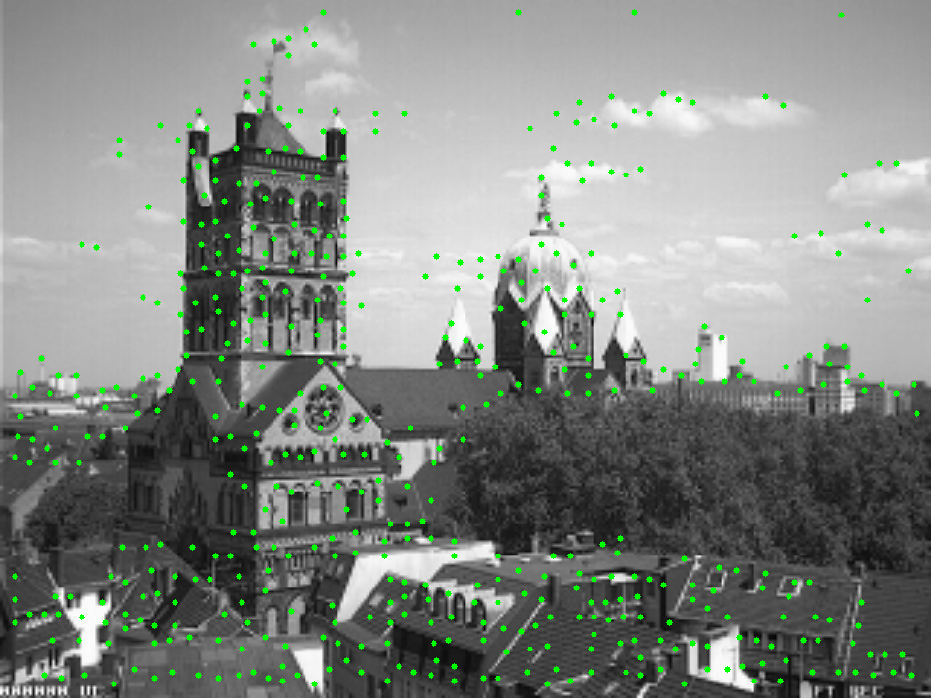
2: Homography adaptation -- get better keypoints
Why do we need this? Generate pseudo ground truth to train descriptor
(the image is w/o HA)

Slide 15
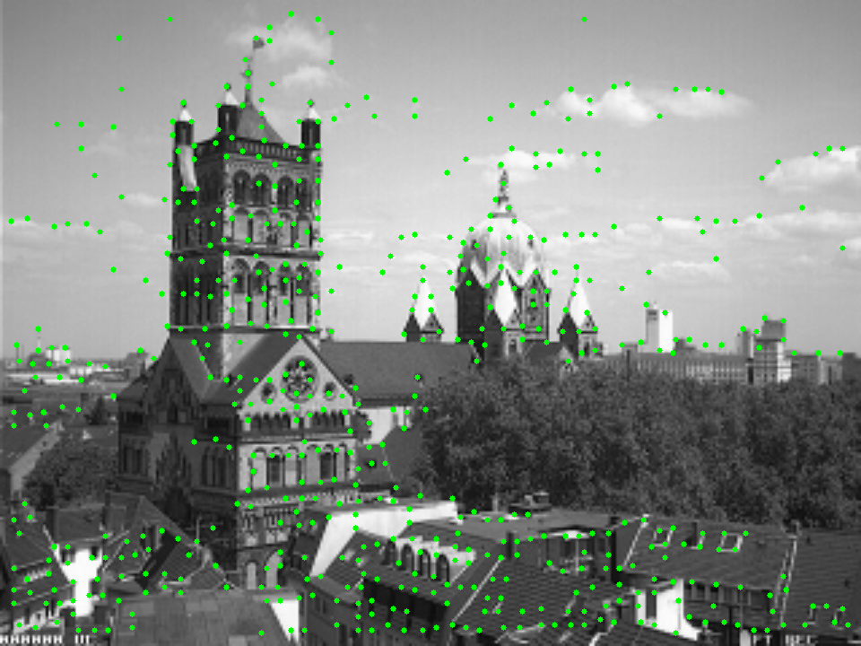
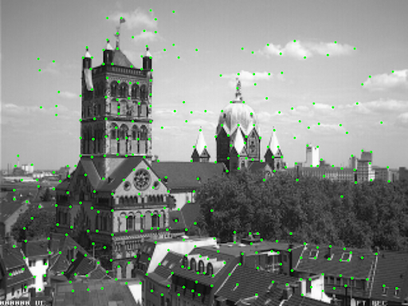
Homography adaptation - 100
100 iterations. vs. MagicLeap model

Slide 16
This time

Slide 17
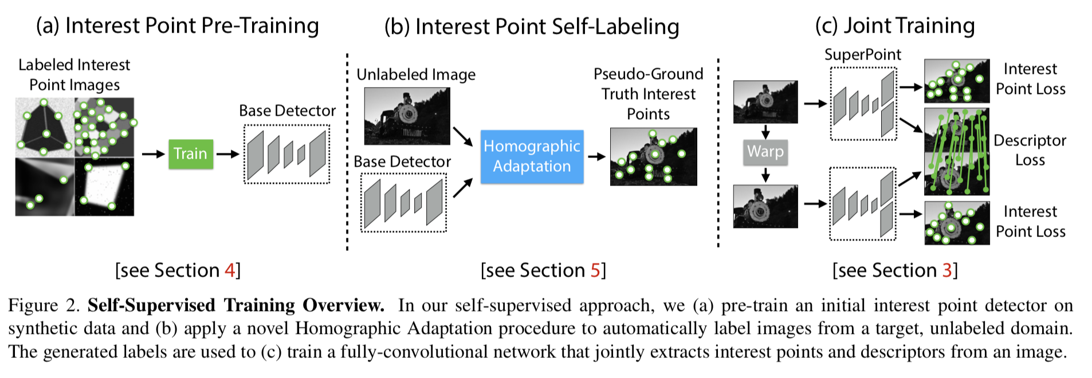
Superpoint pipeline

Slide 18
How to evaluate?
Training:
Detector: Precision/ Recall
Testing:
Hpatches
Dataset with ground truth homography
Viewpoint scenes/ Illumination scenes
Detector: repeatability
Descriptor: homography estimation

Slide 19
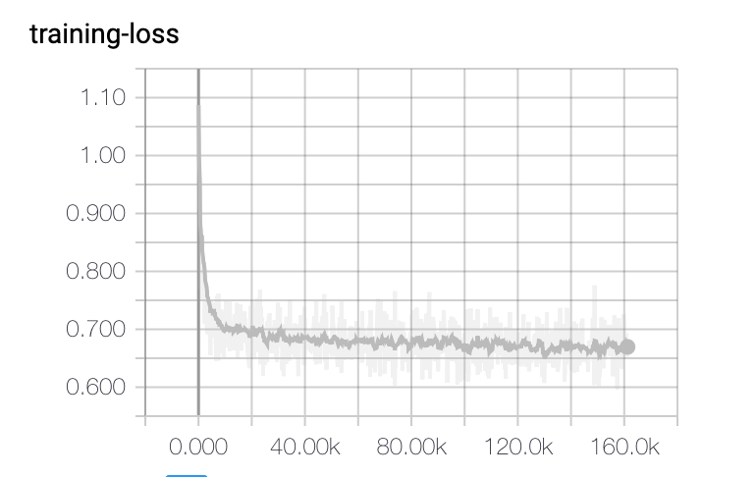
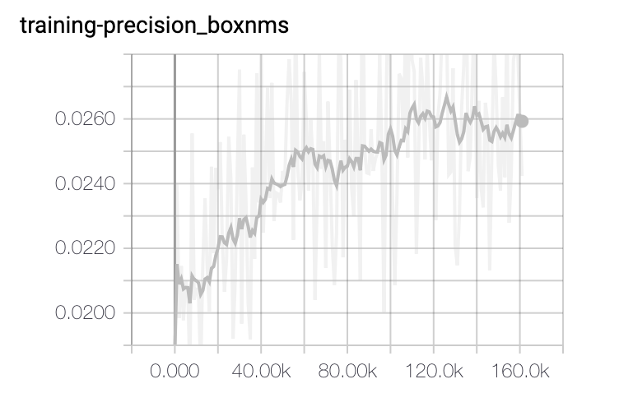
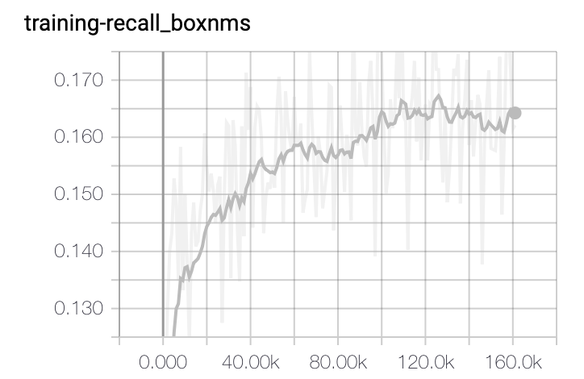
Training curve -- train detector on COCO

Slide 20
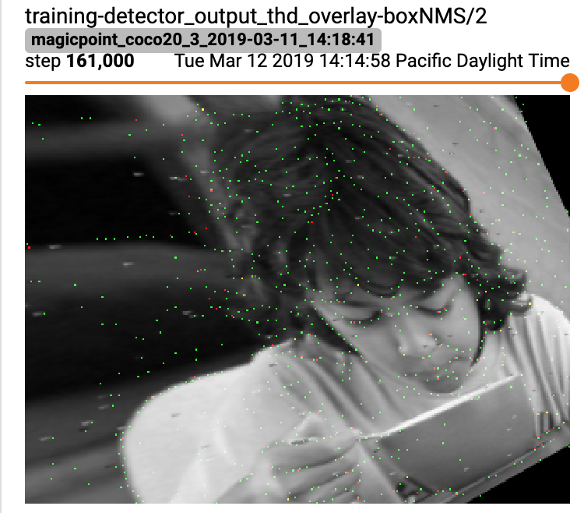

Slide 21
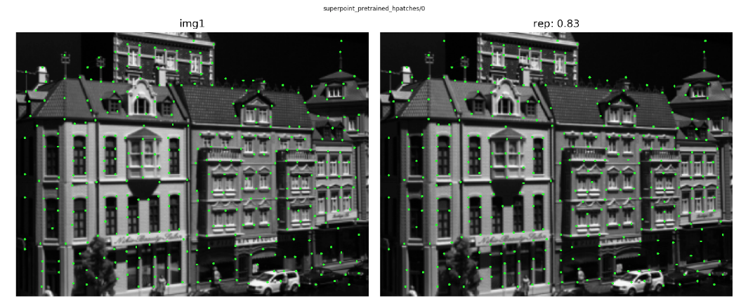
Detector repeatability
Given ground truth homography, or just identity matrix (3x3)
Percentage of the points on image 1 repeats on image 2

Slide 22
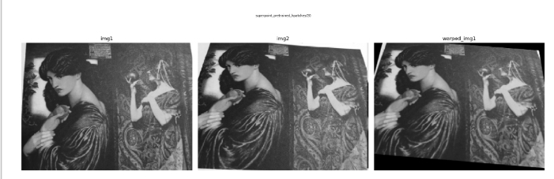
Descriptor: Homography Estimation
Homography estimation on HPatches computed with
maximum of 1000 points detected in images
Non-Maximum Suppress (NMS) of 8:
threshold of correctness of 3 (4 corners reprojection)
Homography warping

Slide 23
Pretrained model

Slide 24
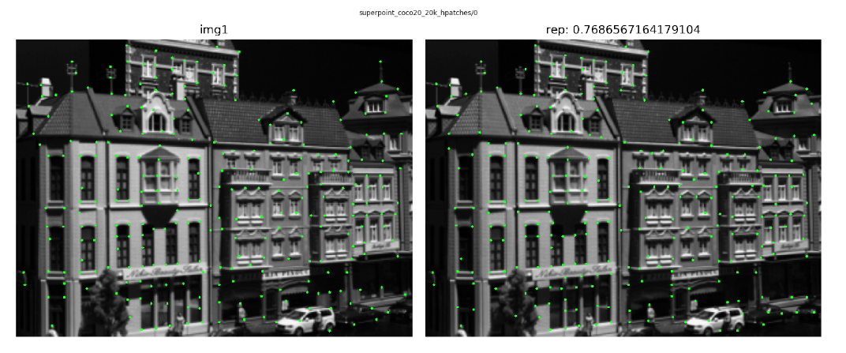
Our model

Slide 25
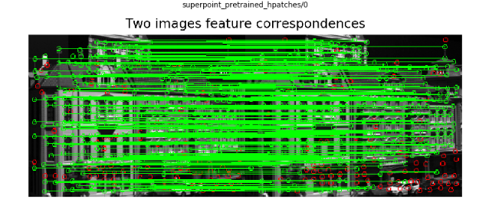
Pretrained model

Slide 26
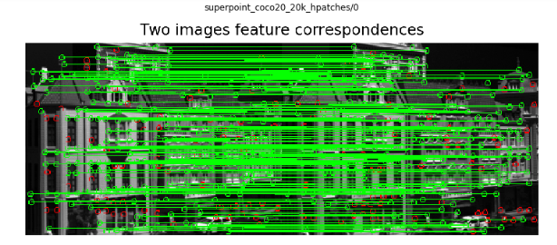
Our model

Slide 27
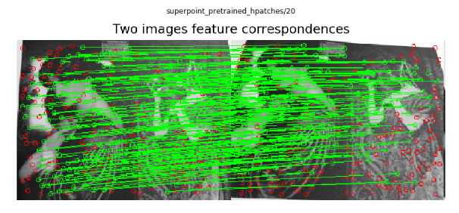
Pretrained model

Slide 28
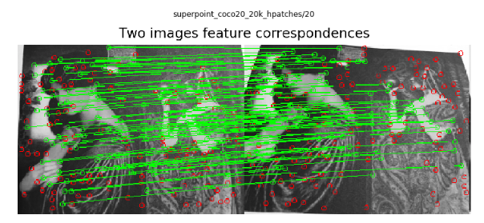
Our model

Slide 29
Pretrained model

Slide 30
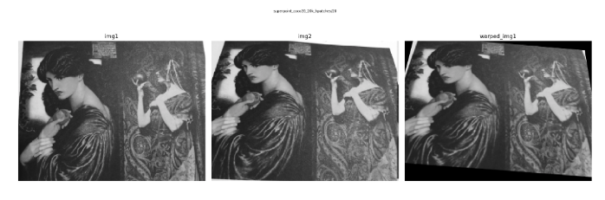
Our model

Slide 31
Quantitative results
 | repeatability | homography estimation
pretrained | 0.563 | 0.710
Superpoint_coco20_20k_hpatches (add BN, fix label shifting) | 0.526 | 0.698

Slide 32
Work on Kitti

Slide 33
Superpoint pipeline

Slide 34
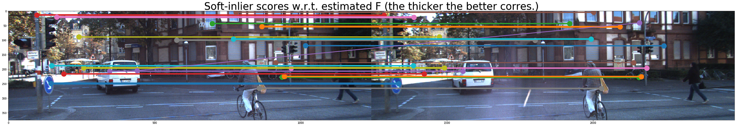
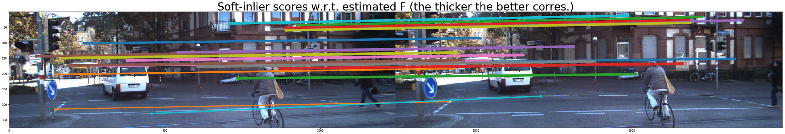
Results
Finished DSAC on any KITTI image pairs (left/right, I_{t}/I_{t+\delta t}) with SIFT/SuperPoint corres.
left/right: Error_rot = 0.35, Error_trans = 0.03
I₀/I₃: Error_rot = 0.05, Error_trans = 3.61

Slide 35
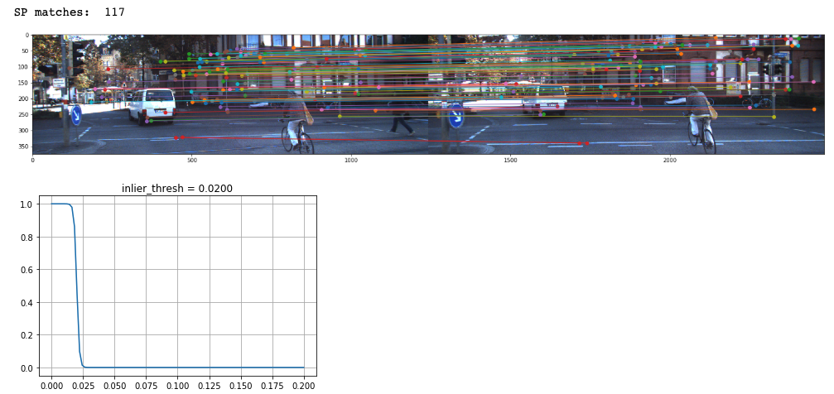
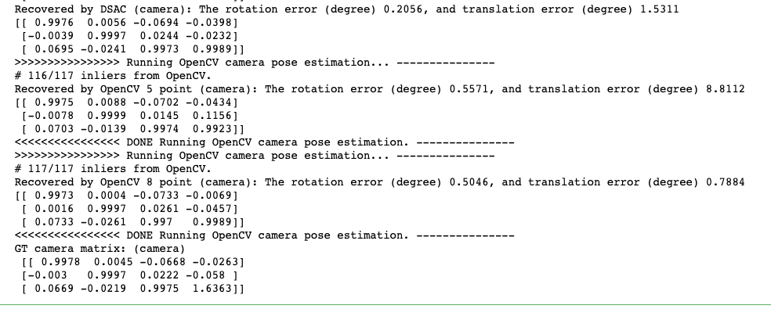
Pretrained model

Slide 36
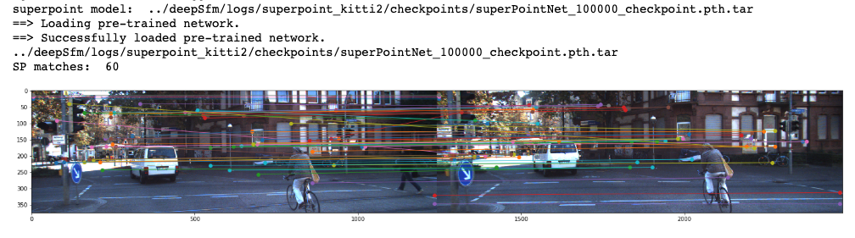
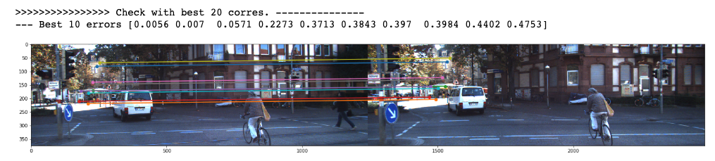
Our kitti model

Slide 37
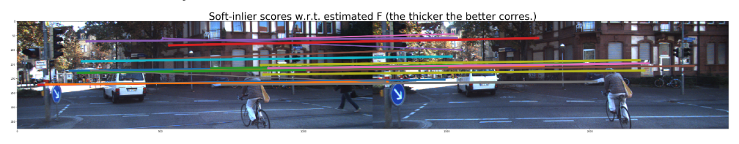
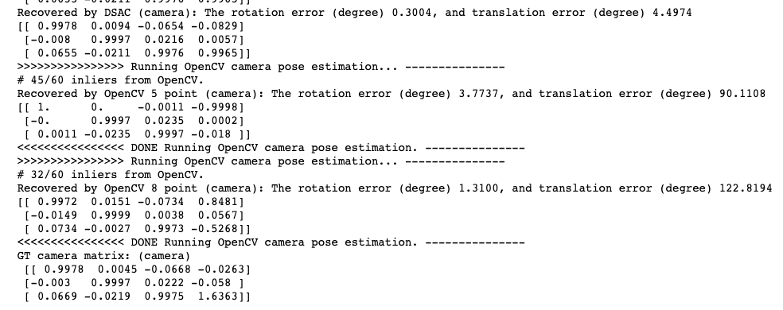

Slide 38
Problems
kitti dataset has larger image size:
Kitti: (1242 , 375) → Downsize to (96, 312) → coarse image
COCO dataset: (480, 640) → (240, 320)
Resolution of training is not good
Tune our model

